Slide 1
Hack the Future:
A Gen AI Sprint Powered by Data

Slide 2





Hack the Future: A Gen AI Sprint Powered by Data
Data and AI Week
Team details
TEAM NAME: Companion AI
Mukul Agarwal
Ayush Agrawal
Photo

Slide 3
Entry Submission Summary
Idea Title | Empowering Elderly Care with Multi-Agent AI System
Team Name | Companion AI
Problem Statement | Develop an AI-driven multi-agent system to support elderly individuals with real-time monitoring, safety alerts, health management, daily reminders, and collaborative care involving family and professionals.
Proposed Solution | Our proposed solution leverages multi-agent systems and large language models (LLMs) to monitor elderly individuals using data from various health sensors. The LLM based system independently analyzes real-time vitals and delivers detailed, actionable insights to doctors, caregivers, and family members. It offers personalized reminders tailored to the individual's routine—such as medication, appointments, and daily activities—and provides timely support in critical situations. Designed for minimal human intervention, the platform ensures consistent, automated care while promoting independence. Additionally, it generates comprehensive health summaries for medical professionals.

Slide 4
Problem statement you are trying to address
Challenge Overview:
As the global population ages, ensuring the well-being of elderly individuals living independently presents a major challenge.
The goal of this hackathon is to develop a multi-agentic AI system that assists elderly individuals by providing real-time monitoring, reminders, and safety alerts, while promoting health management and social engagement. The agents will work together to create a collaborative support system, involving caregivers, healthcare providers, and family members to ensure optimal care and peace of mind.
The system should monitor health, detect unusual behavior, and provide alerts in case of emergencies. It should also provide reminders to manage daily routines, such as medication schedules, appointments, and daily activities.
Current Process:
ADAS system: Collects and Monitors driving data (e.g., sensor data, environment data) and gets alerted if abnormal values are detected.
Safety Monitoring System: Uses sensor data and detects anomalies in the sensor data maybe due to environment, physical of cyber attacks which created the anomalies
Scheduled maintenance System: Provides scheduled maintenance of the vehicle and informs the concerned on such anomalies be it commercial or passenger vehicle(cars/trucks)
Expected Technical Output: Multiagent framework

Slide 5
Proposed Solution Overview
Our solution leverages a multi-agent system powered by Large Language Models (LLMs) to intelligently process and analyze patient sensor data. The system is composed of a sequence of specialized agents, each responsible for a distinct stage in the health monitoring pipeline.
The process begins with the Sensor Agent, which ingests and evaluates raw sensor data. This agent is capable of detecting anomalies and determining whether the data is usable. If the data is found to be irreparably corrupted, the Sensor Agent generates a warning message indicating “corrupted data beyond repair” and transitions to an END state before moving on to the next patient record. If the data is valid, it is passed to the next agent in the chain.
The Health Monitoring Agent, powered by an LLM, receives the clean sensor data and generates comprehensive diagnostic insights. This includes identifying abnormal readings, correlating multiple irregularities, and assessing their potential criticality. For each input, the agent provides an explanation of concerns—such as values outside of the normal range or dangerous combinations of indicators.
These insights are then forwarded to the Alert Agent, which further analyzes the diagnostics to determine the patient's condition. If the situation is deemed critical, the agent generates an alert summarizing the abnormalities and notifies the appropriate stakeholders—such as the nurse, doctor, or family members—before transitioning to the END state.

Slide 6
Proposed Solution Overview
If the condition is non-critical, the Alert Agent passes the data to the Daily Reminder Agent. This LLM-powered agent uses the diagnostic data and current context (e.g., time of day) to provide personalized recommendations for routine health-related activities such as meals, medication, physical activity, and appointments. After delivering these suggestions, it also transitions to the END state.
The system then repeats this process for the next patient record, ensuring continuous and intelligent monitoring across multiple patients.

Slide 7
Technologies Used
Python
Ollama
Pydantic_ai
Pydantic
LangGraph
VS Code
Streamlit

Slide 8
Agents' interaction design
Patient’s Data
Sensor Agent
Health Monitoring Agent
END
Alert Agent
Daily Reminder Agent
END

Slide 9
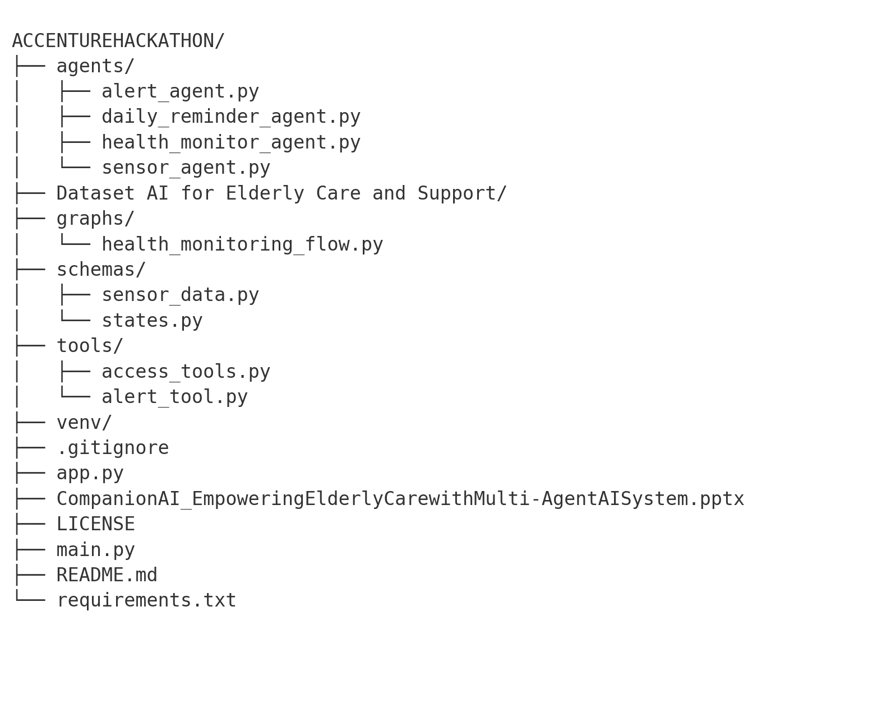
Code structure

Slide 10
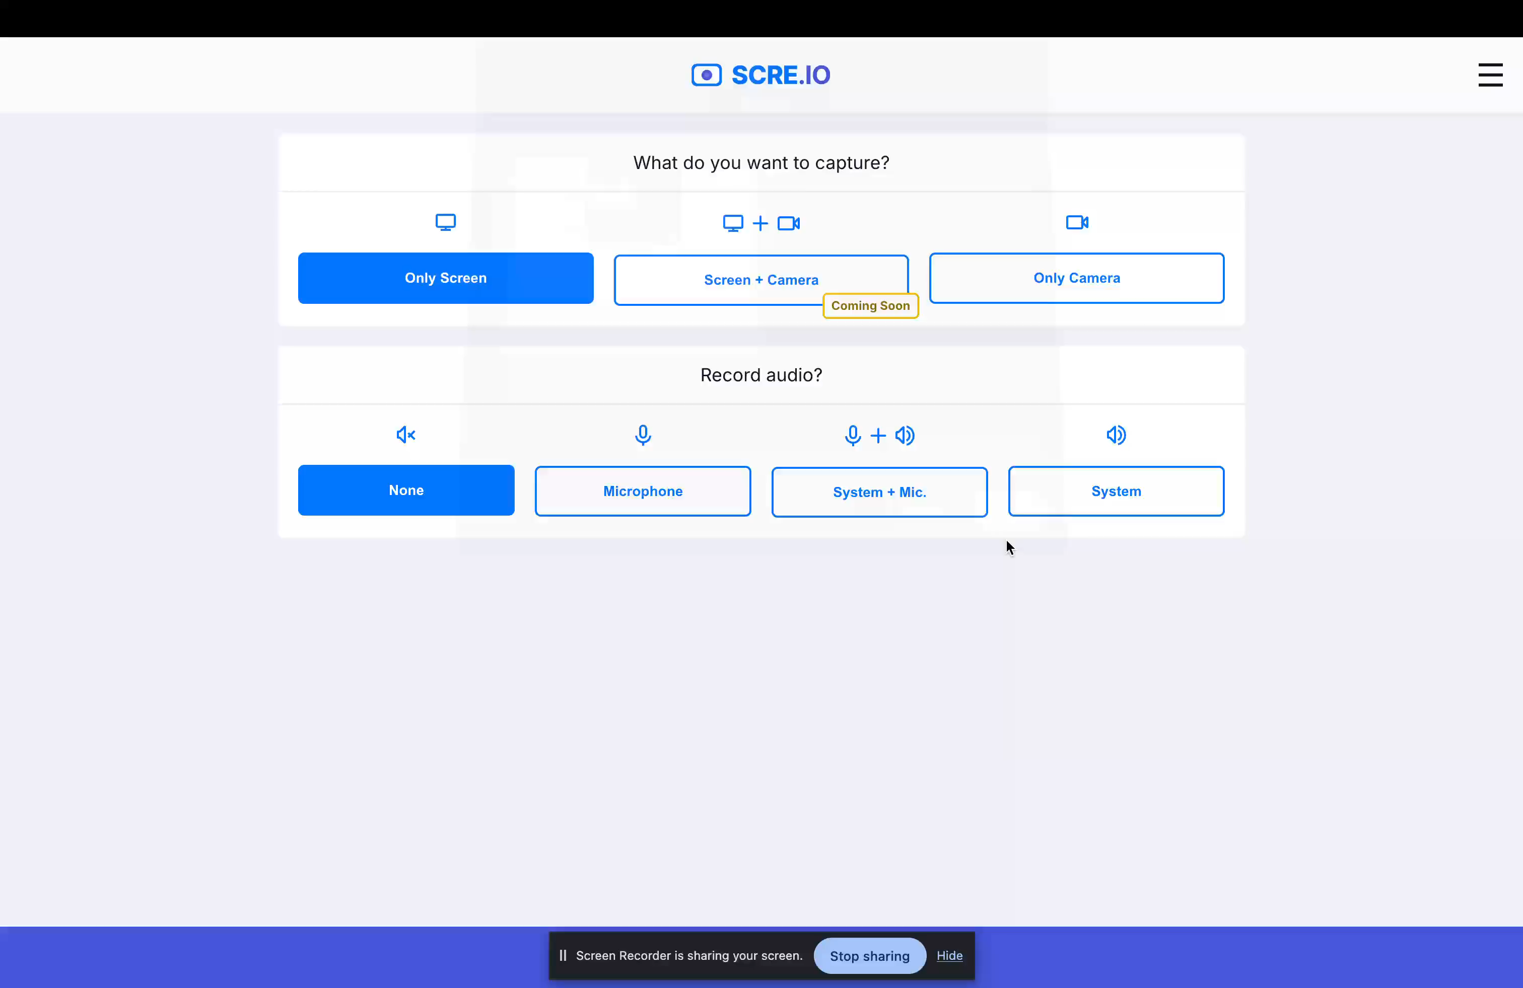
Demo video

Slide 11
Conclusion
Our approach leverages Large Language Models (LLMs) for intelligent analysis and decision-making in healthcare settings, all under human supervision. The primary goal is to streamline the often time-consuming process of collecting and interpreting patient data.
The system generates well-structured, easy-to-understand reports tailored for caregivers, doctors, and patients alike. It can automatically trigger emergency alerts and provide personalized reminders—all with minimal human intervention. Importantly, all LLMs are deployed locally, ensuring enhanced data security and privacy for sensitive patient information.
The solution is designed to be resilient—even in cases where data is missing or corrupted. It is also scalable, capable of integrating additional sensors or data sources without requiring major rework.
Our vision is to deliver a robust, user-friendly platform that supports not only current healthcare needs but is adaptable for future enhancements. Potential features include:
A user dashboard for real-time vital tracking
Doctor appointment scheduling
Emergency services integration (e.g., ambulance dispatch)
Advanced recommendations such as identifying the most suitable doctors or nearby hospitals
Integration of additional data sources for deeper insights
This solution aims to bridge the gap between complex medical data and actionable insights—empowering both healthcare providers and patients.

Slide 12
References/Other details
LangGraph: Framework for building composable, state-based workflows with LLMs.
Streamlit: Tool for building fast, interactive web apps in Python.
Pydantic: Used for data parsing and validation using Python type annotations.
Pydantic AI: Seamlessly integrates Pydantic with LLMs for structured output from natural language.
Ollama: Runs large language models efficiently and securely on local machines.
LLaMA Models: Open-source foundational language models developed by Meta for various NLP tasks

Slide 13
References/Other details
LangGraph: LangGraph: State-based orchestration for large language models. Available at: https://github.com/langchain-ai/langgraph
Streamlit: Streamlit: Turn data scripts into shareable web apps in minutes. Available at: https://streamlit.io
Pydantic: Colvin, S. Pydantic: Data validation and settings management using Python type annotations. Available at: https://docs.pydantic.dev
Pydantic AI: Pydantic AI: Structured output for LLMs using Pydantic models. Available at: https://docs.pydantic.dev/latest/integrations/ai/
Ollama: Ollama: Run large language models locally. Available at: https://ollama.com
LLaMA (Large Language Model Meta AI): Touvron, H., et al. (2023). LLaMA: Open and Efficient Foundation Language Models. Meta AI. Available at: https://ai.facebook.com/blog/large-language-model-llama-meta-ai/

Slide 14

Thank You

